Slide 1










KS4-5 SUBJECT-SPECIFIC
SLIDE RESOURCES
Slide pack to support linking careers to the curriculum
careerpilot.org.uk

Slide 2




Teacher notes
These slides can be used by subject teachers to make the link to careers through subject lessons.
Open slides in ‘Slide View’ in PowerPoint – you can view notes in the presenter view.
Choose the subject from the contents slide.
There are five slides for each subject, the first two slides show an example of jobs, courses and apprenticeships related to your subject area.
Then click on the blue button at the bottom of second slide to go to the following three slides to show students how to use Careerpilot to research careers and pathways further.
Please note - all students are eligible to set up a FREE account on Careerpilot which they can use until they are 20. It takes minutes to register for an account from the top right of the home page. Students can then log in on any device to build their own Career Tools, saving any jobs, courses, providers or apprenticeships they may be interested in.
Additional Teaching Resources for Subject Teachers
Top Tips for linking careers to the curriculum
Download an accompanying booklet with top tips, links and videos to support teaching students how to find out more about careers related to their subject.
Subject Specific Careers Posters
Request a set of 21 subject posters to download and print to introduce students to related jobs, courses and apprenticeships.
www.careerpilot.org.uk/adviser-zone/resources-for-subject-teachers-gatsby-benchmark-4
careerpilot.org.uk

Slide 3





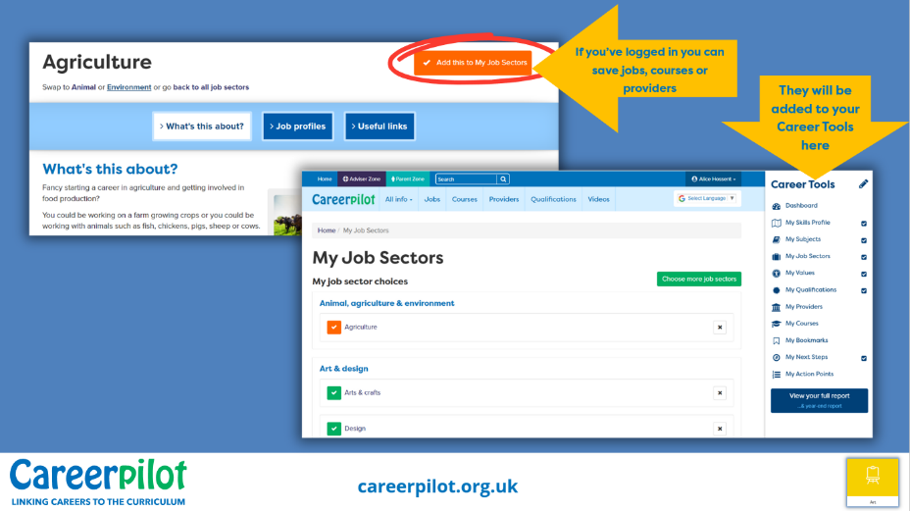

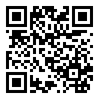

Introducing Careers for Subject Teachers
Slides can be used as a quick starter activity, or as a longer session as required.
Slide 1 introduces examples of careers linked to your subject area.
Click on the subject symbol bottom right to explore these and other related Careerpilot job profiles and videos with the class, looking at salary, job growth and routes in.
Slide 2 introduces examples of post 16 and post 18 courses and apprenticeships linked to your subject area. You may discuss local providers where students can study these courses in your local area.
Click on the blue button at the bottom of the slide to take you to slide 3.
Slide 3 and 4 show students how they can use Careerpilot to research jobs, courses, local providers and apprenticeships linked to their subject.
Slide 5 shows students how they can view videos of people talking about jobs, courses and apprenticeships related to their subject.

Slide 4










Contents
careerpilot.org.uk

Slide 5


Where could you take your love of
Art & Design?
Future Careers Ideas
  Animator
  Art Therapist
  Architect
  Advertising Art Director
  Fashion Designer
  Illustrator
  Interior Designer
  Photographer
Notes:
Teachers – ask students to come up with some ideas of jobs related to Art and Design, then click to reveal some examples. You can click on any of these to open up a job profile to find out more.

Slide 6


What pathways could you take to get there?
Post-16 Options
Post-18 Options
Courses:
  A-level Art and Design
  A-level Fashion & Textiles
  Level 3 Graphic Design & Photography
  Level 1-3 Art and Design
Apprenticeships:
  Community Arts
  Fashion Studio Assistant
Example of Degree Courses:
  BA (Hons) Fashion Design
  BA (Hons) Drawing
  BA (Hons) Commercial Photography
Apprenticeships:
  Junior Animator
  Photographer
Click here to go to next slides showing how to use Careerpilot to research jobs
Notes:
You may discuss post 16 pathways and/or post 18 pathways (delete section if not relevant to your students). You may mention local providers that you know offer some of these courses.
NB. Use the blue button at the bottom to move to the next slide.

Slide 7


Where could you take your love of
Computing?
Future Careers Ideas
App Developer
Audio Visual Technician
Forensic Computer Analyst
Software Developer
IT Support Technician
Web Developer
Automotive Engineer
Cyber Intelligence Officer
Notes:
Teachers – ask students to come up with some ideas of jobs related to Art and Design, then click to reveal some examples. You can click on any of these to open up a job profile to find out more.

Slide 8

What pathways could you take to get there?
Post-16 Options
Post-18 Options
Courses:
A-Level Computer Science
T-Level Digital
Level 1-2 Computing & IT
Apprenticeships:
Digital Support Technician
Cyber Security Technician
Example of Degree Courses:
BSc (Hons) Computer Science
BSc (Hons) Creative Computing
BSc (Hons) Cyber Security
Apprenticeships:
Software Developer
Digital & Tech Solutions
Click here to go to next slides showing how to use Careerpilot to research jobs
Notes:
You may discuss post 16 pathways and/or post 18 pathways (delete section if not relevant to your students). You may mention local providers that you know offer some of these courses.

Slide 9


Where could you take your love of
English?
Future Careers Ideas
Advertising Copywriter
Arts Administrator
Broadcast Journalist
Commissioning Editor
Digital Marketer
Newspaper Journalist
Teacher
Tourist Guide
Notes:
Teachers – ask students to come up with some ideas of jobs related to Art and Design, then click to reveal some examples. You can click on any of these to open up a job profile to find out more.

Slide 10

What pathways could you take to get there?
Post-16 Options
Post-18 Options
Courses:
A-Level English
T-Level Marketing
Level 2-3 Creative Media
Apprenticeships:
Broadcast Production Assistant
Digital Marketer
Example of Degree Courses:
BA (Hons) Journalism & Creative Writing
BA (Hons) English and Creative Writing
BA (Hons) English Literature
Apprenticeships:
Public Relations Assistant
Journalist
Click here to go to next slides showing how to use Careerpilot to research jobs
Notes:
You may discuss post 16 pathways and/or post 18 pathways (delete section if not relevant to your students). You may mention local providers that you know offer some of these courses.

Slide 11
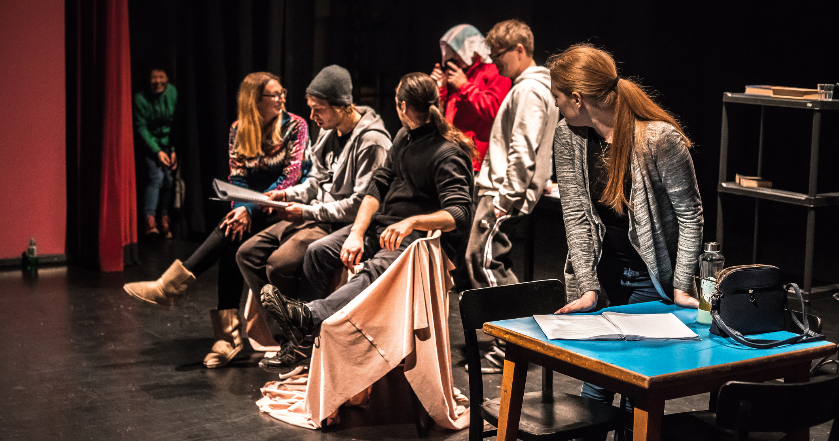

Where could you take your love of
Drama?
Future Careers Ideas
Arts Administrator
Choreographer
Community Arts Worker
Dance Teacher
Dancer
Actor
Drama Therapist
Stage Manager
Notes:
Teachers – ask students to come up with some ideas of jobs related to Art and Design, then click to reveal some examples. You can click on any of these to open up a job profile to find out more.

Slide 12
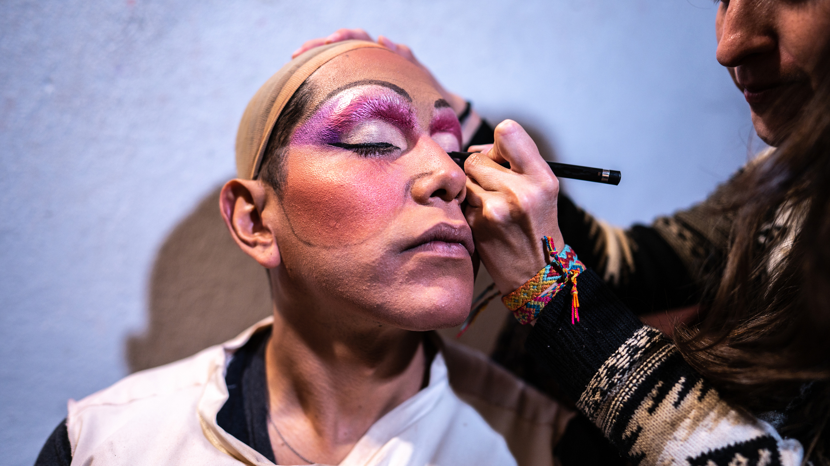
What pathways could you take to get there?
Post-16 Options
Post-18 Options
Courses:
A-Level Dance
A-Level Drama
BTEC Performing Arts
Apprenticeships:
Community Activator Coach
Cultural Learning and Participation Officer
Example of Degree Courses:
BA (Hons) Theatre and Performance Studies
BA (Hons) Dance & Choreography
BA (Hons) Performing Arts Education
Apprenticeships:
Teacher
Arts Therapist
Click here to go to next slides showing how to use Careerpilot to research jobs
Notes:
You may discuss post 16 pathways and/or post 18 pathways (delete section if not relevant to your students). You may mention local providers that you know offer some of these courses.

Slide 13
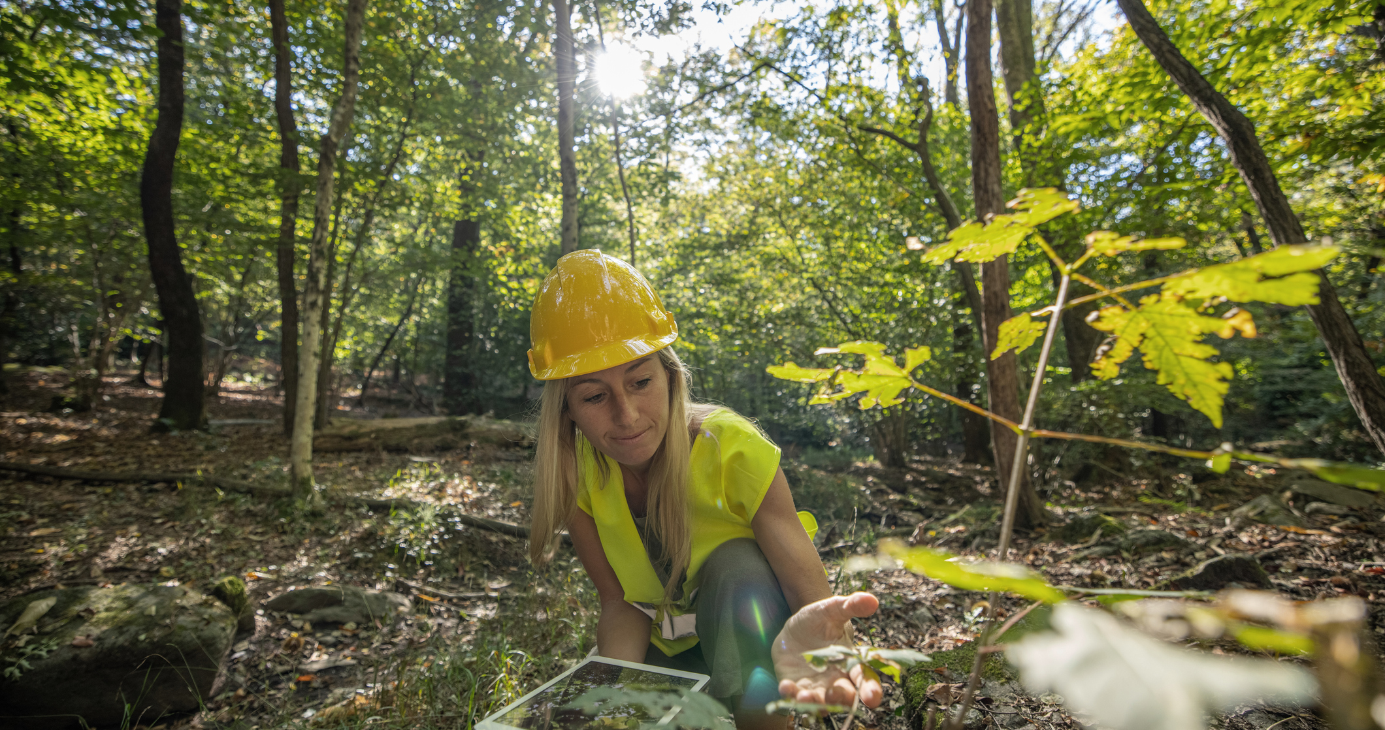

Where could you take your love of
Geography?
Future Careers Ideas
Climate Scientist
Countryside Ranger
Ecologist
Forest Officer
Geoscientist
Land Surveyor
Landscape Architect
Town Planner
Notes:
Teachers – ask students to come up with some ideas of jobs related to Art and Design, then click to reveal some examples. You can click on any of these to open up a job profile to find out more.

Slide 14


What pathways could you take to get there?
Post-16 Options
Post-18 Options
Courses:
A-Level Geography
A-Level Environmental Science
Level 3 Countryside Management
Apprenticeships:
Water Environment Worker
Countryside Worker
Example of Degree Courses:
BSc (Hons) Agriculture
BSc (Hons) Geography
BSc (Hons) Geography with Ocean Science
Apprenticeships:
Environmental Practitioner
Professional Forester
Click here to go to next slides showing how to use Careerpilot to research jobs
Notes:
You may discuss post 16 pathways and/or post 18 pathways (delete section if not relevant to your students). You may mention local providers that you know offer some of these courses.

Slide 15


Where could you take your love of
History?
Future Careers Ideas
Antique Dealer
Archivist
Archaeologist
Art Gallery Curator
Conservator
Heritage Officer
Museum Curator
Tourist Guide
Notes:
Teachers – ask students to come up with some ideas of jobs related to Art and Design, then click to reveal some examples. You can click on any of these to open up a job profile to find out more.

Slide 16
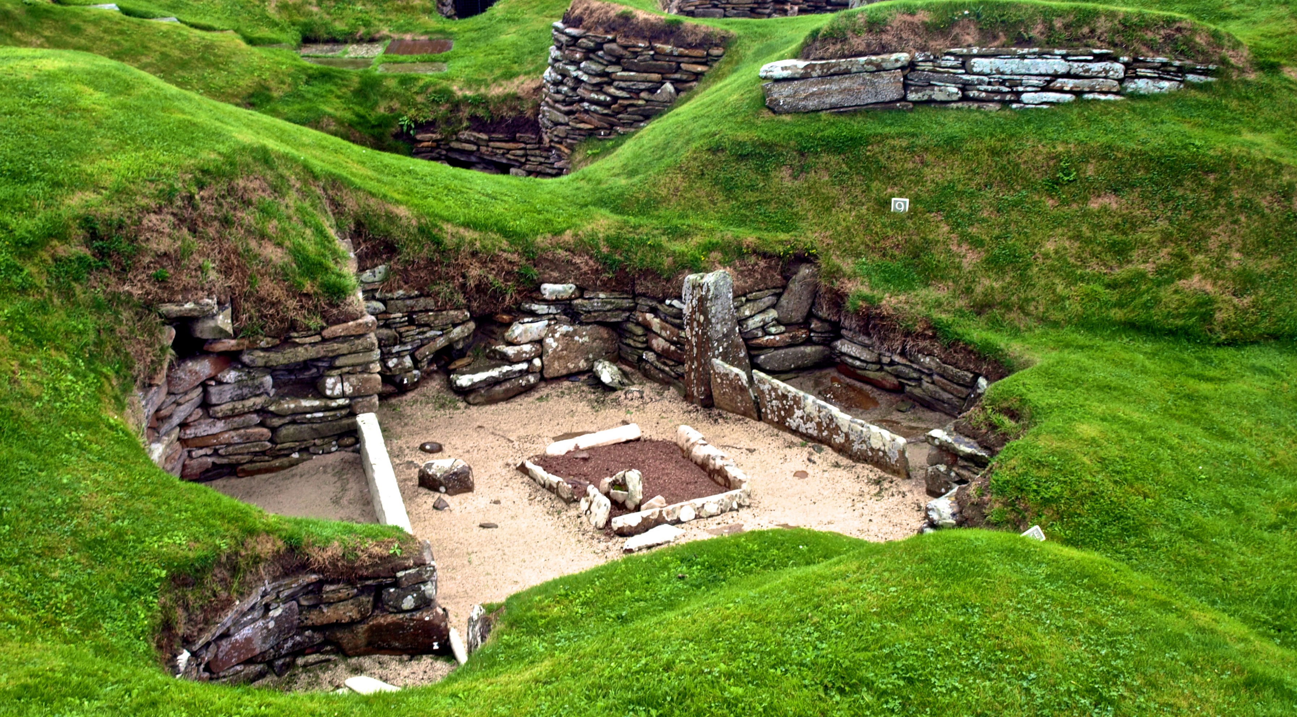

What pathways could you take to get there?
Post-16 Options
Post-18 Options
Courses:
A-Level History
A-Level Classic Civilisation
A-Level Geology
Apprenticeships:
Archaeological Technician
Cultural Learning and Development Officer
Example of Degree Courses:
FDA History, Heritage & Culture
BA (Hons) Ancient History and Archaeology
BA (Hons) History
Apprenticeships:
Cultural Heritage Conservation
Historic Environment Advice Assistant
Click here to go to next slides showing how to use Careerpilot to research jobs
Notes:
You may discuss post 16 pathways and/or post 18 pathways (delete section if not relevant to your students). You may mention local providers that you know offer some of these courses.

Slide 17


Where could you take your love of
Languages?
Future Careers Ideas
Bilingual Secretary
Diplomatic Services Officer
Hotel Manager
Heritage Officer
Teacher
Secondary Teacher
Tourist Guide
Translator
Notes:
Teachers – ask students to come up with some ideas of jobs related to Art and Design, then click to reveal some examples. You can click on any of these to open up a job profile to find out more.

Slide 18
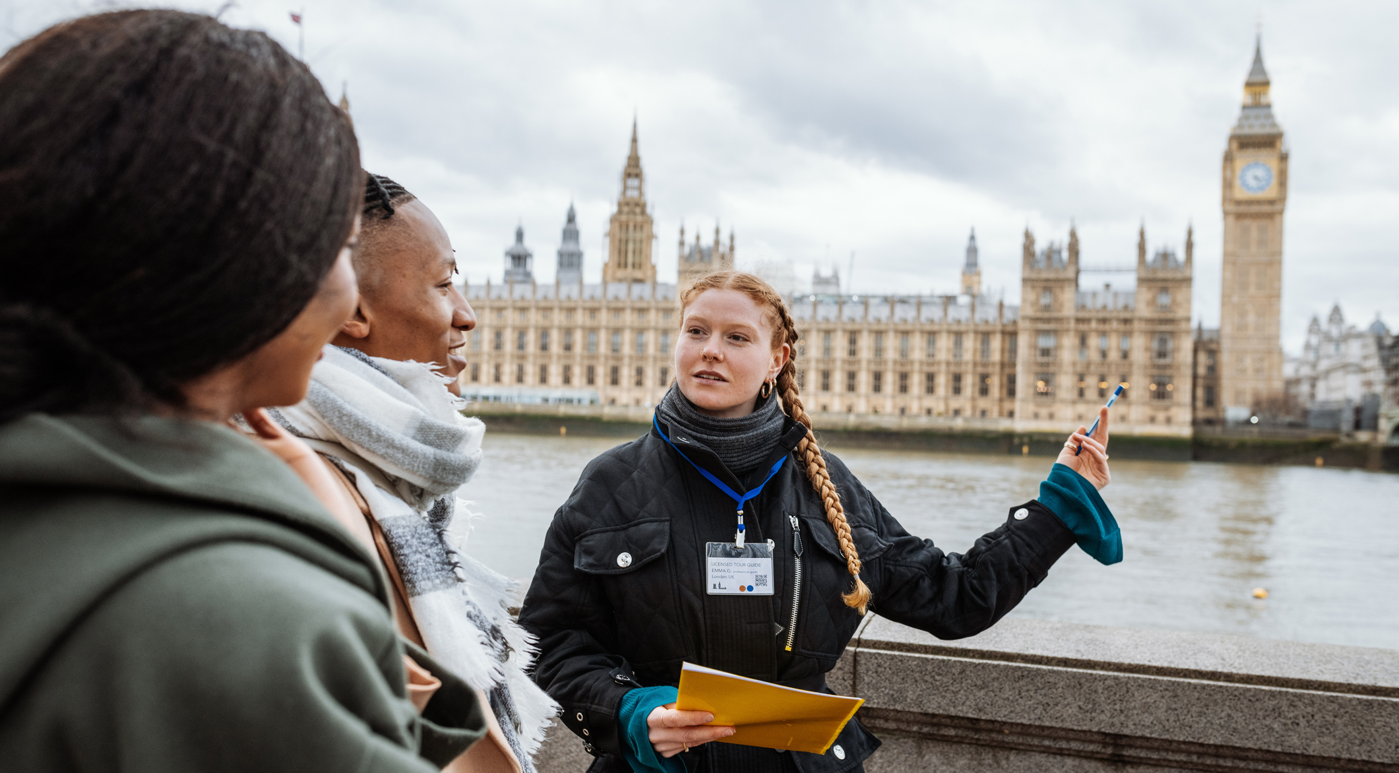
What pathways could you take to get there?
Post-16 Options
Post-18 Options
Courses:
A-Level French
A-Level Spanish
Level 2-3 Travel and Tourism
Apprenticeships:
Cultural Learning and Development Officer
Cabin Crew
Example of Degree Courses:
BA (Hons) French
BA (Hons)Modern Languages
BA (Hons) Communications and Modern Languages
Apprenticeships:
Teacher
Hospitality Manager
Click here to go to next slides showing how to use Careerpilot to research jobs
Notes:
You may discuss post 16 pathways and/or post 18 pathways (delete section if not relevant to your students). You may mention local providers that you know offer some of these courses.

Slide 19


Where could you take your love of
Maths?
Future Careers Ideas
Actuary
Civil Engineer
Data Analyst-Statistician
E-commerce Manager
Air Traffic Controller
Mortgage Advisor
Public Finance Accountant
Stockbroker
Notes:
Teachers – ask students to come up with some ideas of jobs related to Art and Design, then click to reveal some examples. You can click on any of these to open up a job profile to find out more.

Slide 20

What pathways could you take to get there?
Post-16 Options
Post-18 Options
Courses:
A-Level Maths
T-Level Accounting
T-Level Finance
Apprenticeships:
Assistant Accountant
Payroll Administrator
Example of Degree Courses:
BSc (Hons) Mathematics
BSc (Hons) Mathematics with Statistics
BSc (Hons) Mathematics and Data Science
Apprenticeships:
Actuarial Technician
Financial Services Professional
Click here to go to next slides showing how to use Careerpilot to research jobs
Notes:
You may discuss post 16 pathways and/or post 18 pathways (delete section if not relevant to your students). You may mention local providers that you know offer some of these courses.

Slide 21


Where could you take your love of
Music?
Future Careers Ideas
Acoustics Consultant
Audio Visual Technician
Events Manager
DJ
Musician
Music Promotions Manager
Stage Manager
Studio Sound Engineer
Notes:
Teachers – ask students to come up with some ideas of jobs related to Art and Design, then click to reveal some examples. You can click on any of these to open up a job profile to find out more.

Slide 22

What pathways could you take to get there?
Post-16 Options
Post-18 Options
Courses:
A-Level Music
Level 3 Music Performance and Production
Level 3 Music Technology
Apprenticeships:
Live Event Technician
Event Assistant
Example of Degree Courses:
BA (Hons) Music
BA (Hons) Commercial Music
BSc (Hons) Audio and Music Technology
Apprenticeships:
Postproduction Technical Operator
Audiovisual Technician
Click here to go to next slides showing how to use Careerpilot to research jobs
Notes:
You may discuss post 16 pathways and/or post 18 pathways (delete section if not relevant to your students). You may mention local providers that you know offer some of these courses.

Slide 23


Where could you take your love of
the Sciences?
Future Careers Ideas
Chemical Engineer
Dentist
Energy Engineer
Forensic Scientist
Hydrologist
Pharmacist
Laboratory Technician
Sonographer
Notes:
Teachers – ask students to come up with some ideas of jobs related to Art and Design, then click to reveal some examples. You can click on any of these to open up a job profile to find out more.

Slide 24

What pathways could you take to get there?
Post-16 Options
Post-18 Options
Courses:
A-Level Chemistry, Physics or Biology
T-Level Science
T-Level Engineering
Apprenticeships:
Science Manufacturing Technician
Laboratory Assistant
Dental Nurse
Example of Degree Courses:
BSc (Hons) Biochemistry
BSc (Hons) Forensic Science
BSc (Hons) Marine Biology
BSc (Hons) Physics with Astrophysics
Apprenticeships:
Materials Science Technologist
Nursing Associate
Laboratory Scientist
Click here to go to next slides showing how to use Careerpilot to research jobs
Notes:
You may discuss post 16 pathways and/or post 18 pathways (delete section if not relevant to your students). You may mention local providers that you know offer some of these courses.

Slide 25
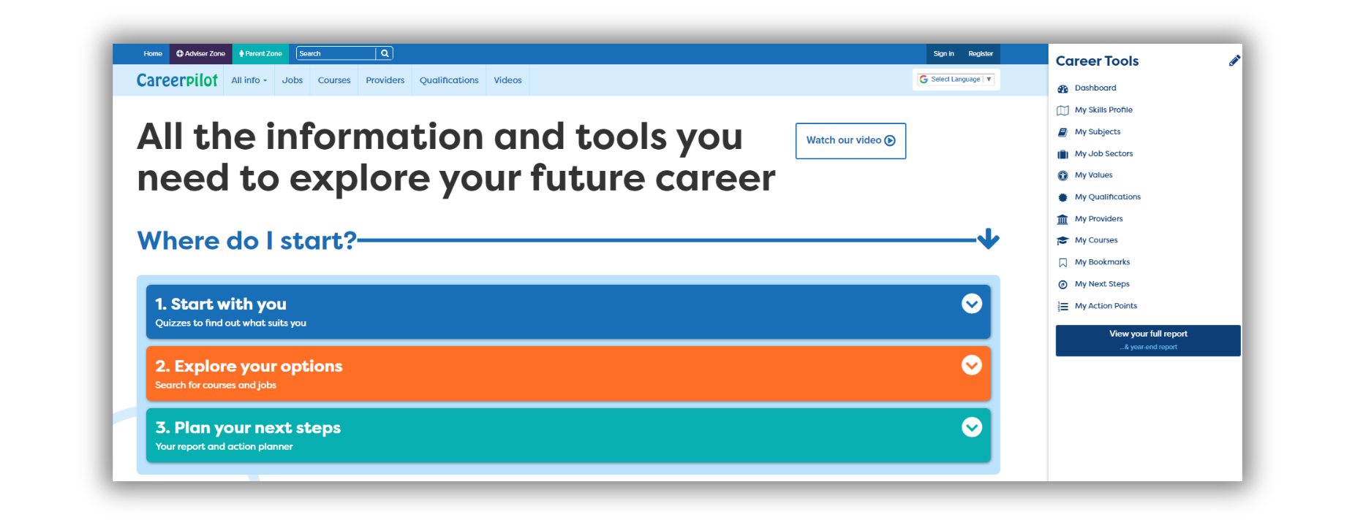

Find out more about jobs, courses and apprenticeships on Careerpilot
Register/log in to Careerpilot here.
Its FREE!
Search for jobs, courses and apprenticeships
Notes:
Show students how to register/log in to Careerpilot and where to find information on jobs, courses and apprenticeships on Careerpilot.

Slide 26
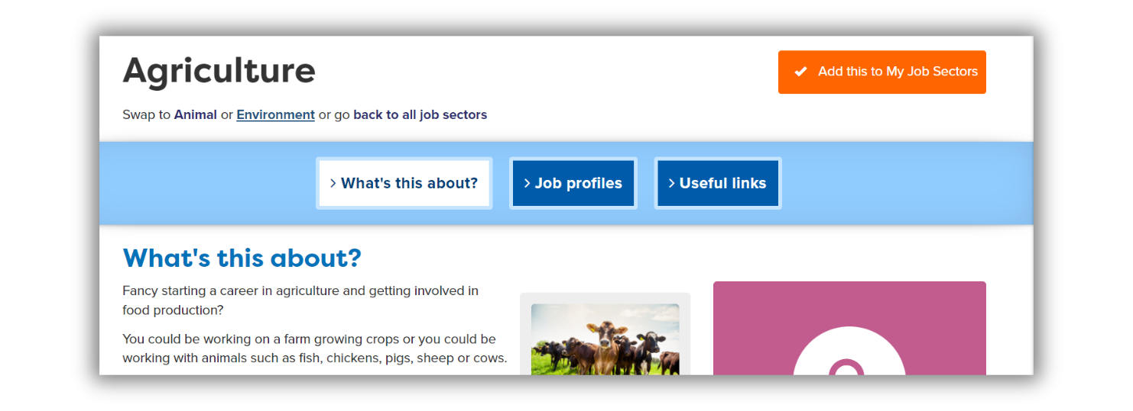
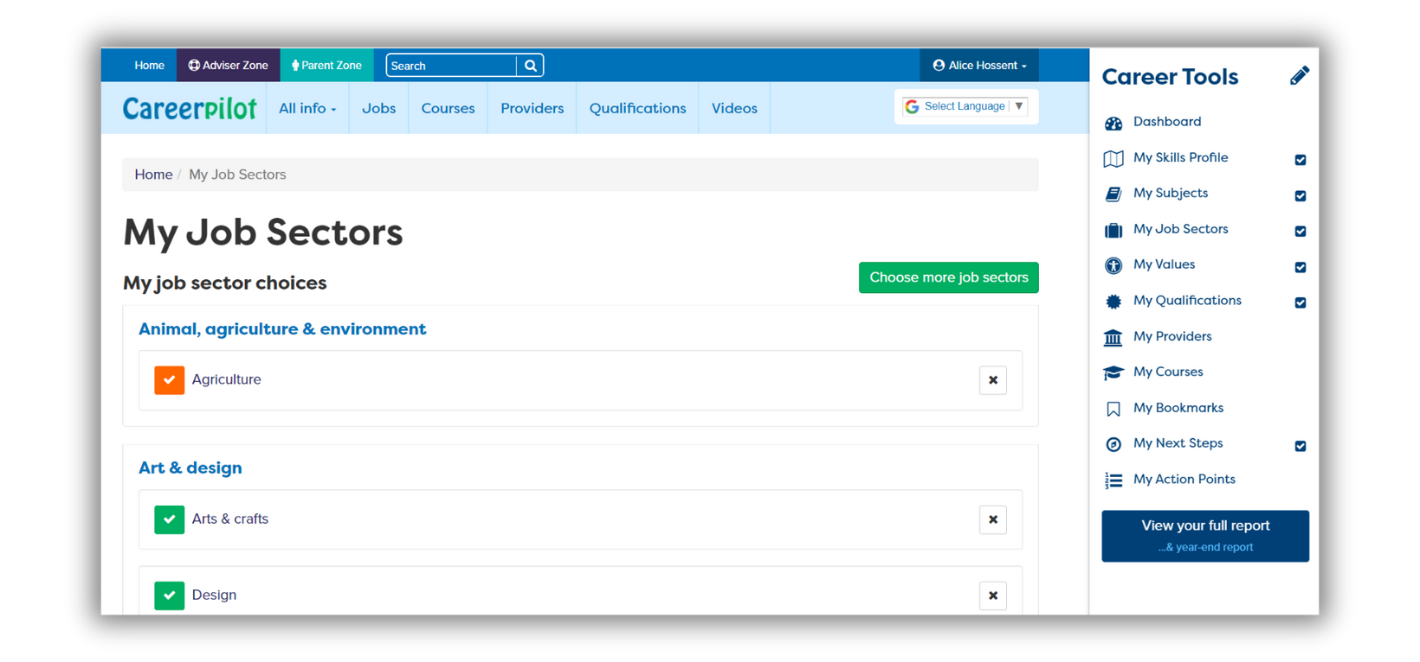
If you’ve logged in you can save jobs, courses or providers
They will be added to your Career Tools here
Notes:
Explain that students can save any jobs, courses, providers or apprenticeships they’re interested in to their Career Tools.

Slide 27
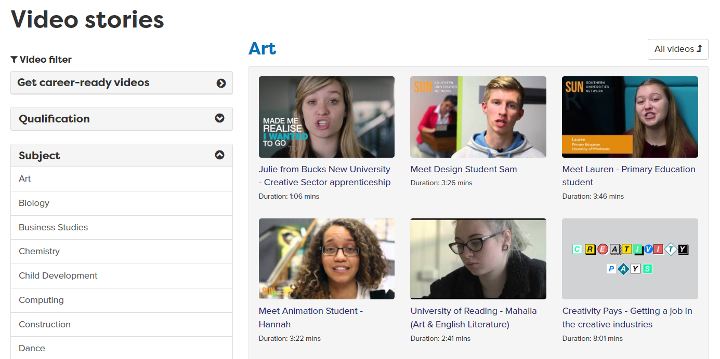
View videos of jobs and courses

